Slide 1
Power BI

Slide 2
About Power BI
Download and install
Starting with Power BI
Import Data
Data cleansing
Report / costume visuals
Publish

Slide 3
About Power BI
Microsoft Power BI is a suite of business intelligence (BI),
Power BI is a business analytics service by Microsoft. It aims to provide interactive visualizations and business intelligence capabilities with an interface simple enough for end users to create their own reports and dashboards.
History
Power BI was conceptualized by Ruler and Dhers Netz of the SQL server coverage services team at Microsoft.
It was designed by West Chadic George in the year 2010 and named as a Project Crescent.
In 2011, It was bundled with SQL Server Codenamed Mount McKinley.
Microsoft unveiled the first preview to Power BI in September 2014.
The first version of Power BI released on 24 July 2015. It was based on Excel Based Add-ins like Power Query, Pivot, view, and Map.

Slide 4
Download and install
Types Of Services
Power BI Desktop
Power BI Services
Power BI Mobile Apps
Download Page

Slide 5
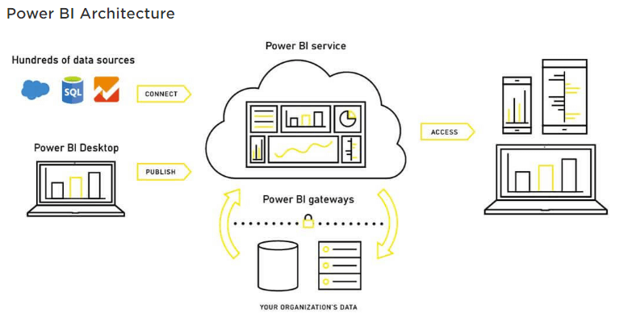
Starting with Power BI

Slide 6
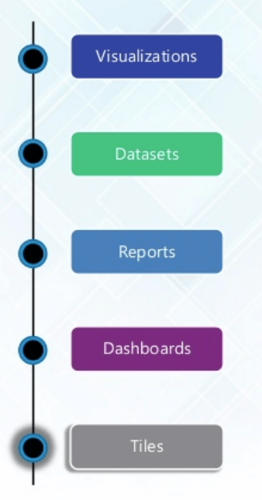
Starting with Power BI

Slide 7
Import Data
Excel
CSV/Files
Web
SQL Server

Slide 8
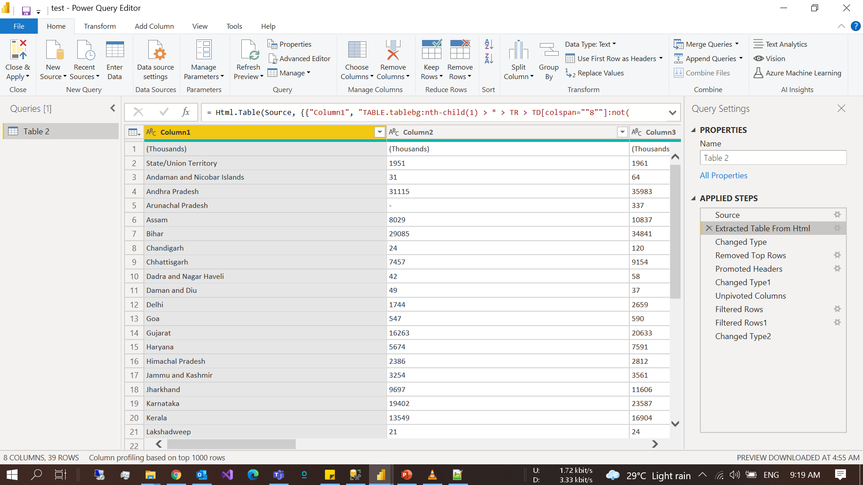
Data cleansing

Slide 9
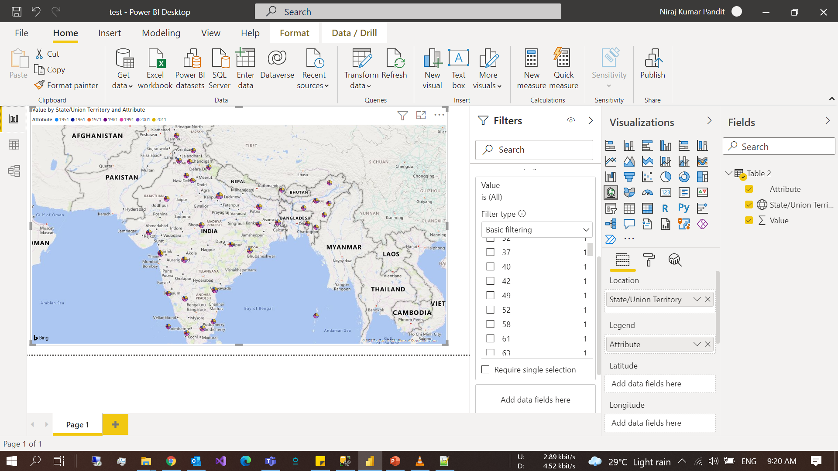
Report / costume visuals

Slide 10
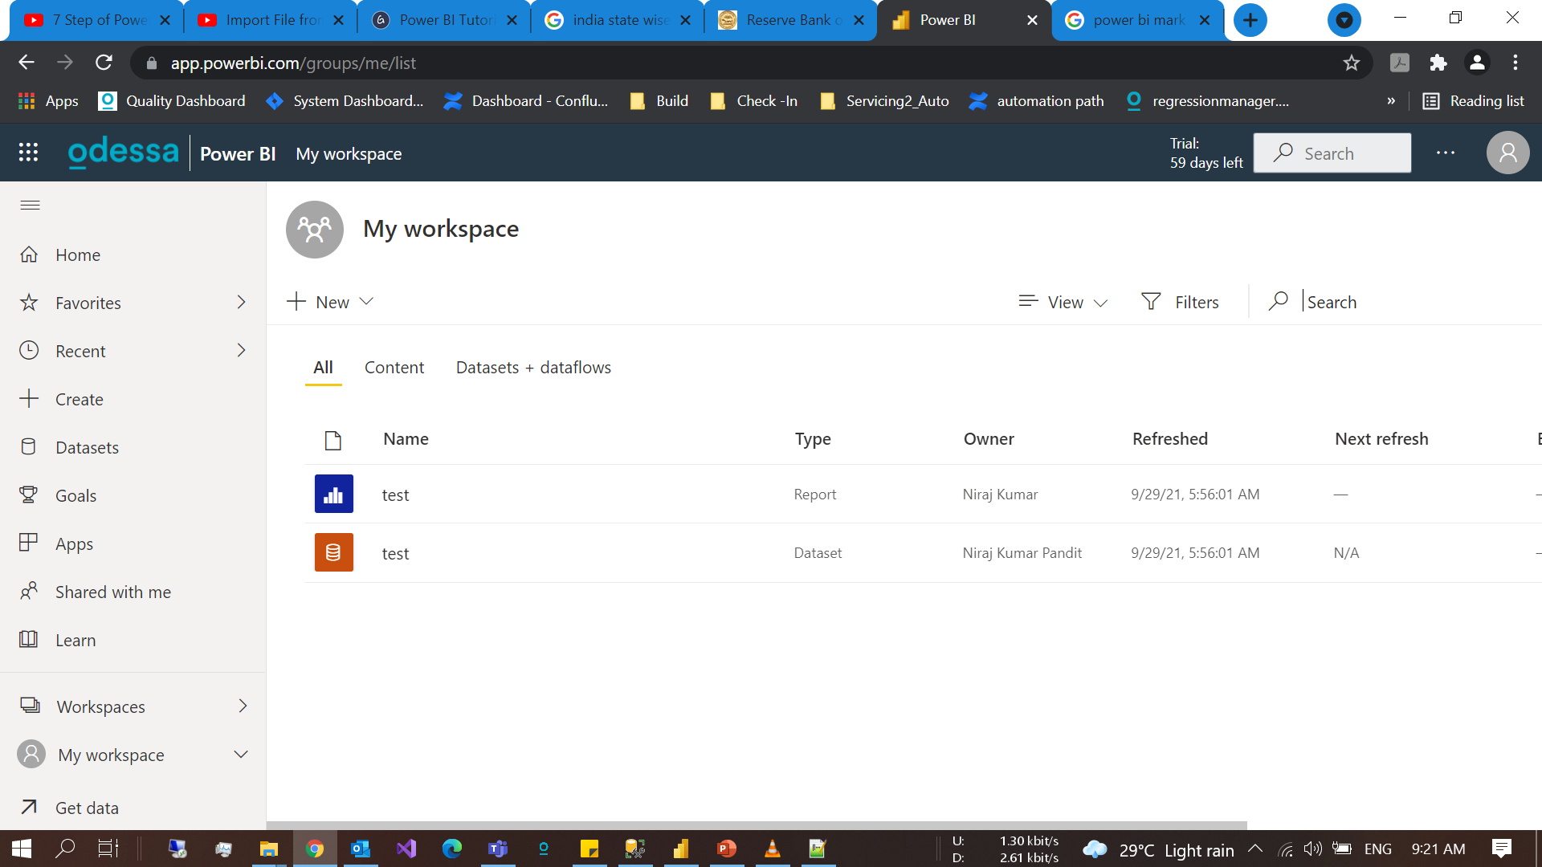
Publish

